Slide 1
ER-2
13.2

Slide 2
Contents
Entity Relationship(ER) diagram
ER Diagram Symbols

Slide 3
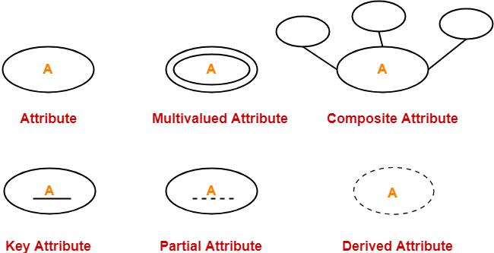
Attribute representation

Slide 4
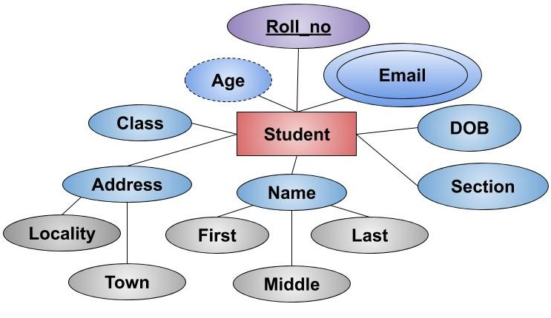
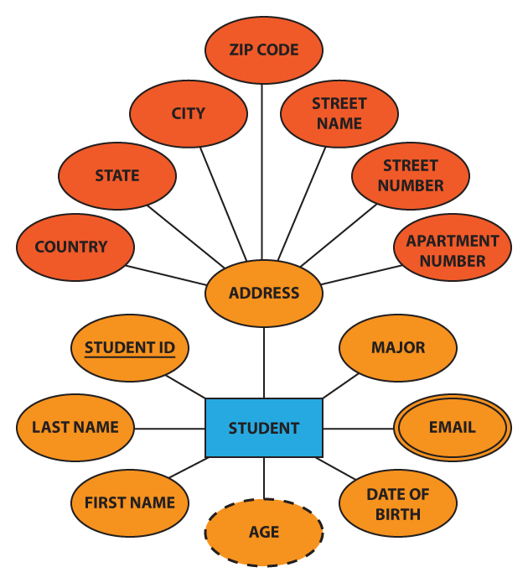
Representation of Entity and Attributes

Slide 5
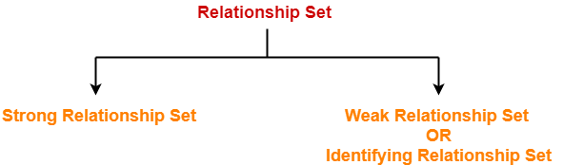
Relationship Sets
Relationship defines an association among several entities.
A relationship set is a set of same type of relationships.

Slide 6
Relationship Sets
Strong Relationship Set-
A strong relationship exists between two strong entity sets.
It is represented using a diamond symbol.
Weak Relationship Set-
A weak or identifying relationship exists between the strong and weak entity set.
It is represented using a double diamond symbol.

Slide 7
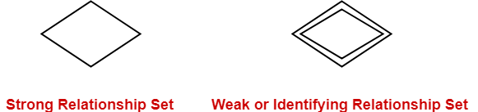
Relationship Sets

Slide 8
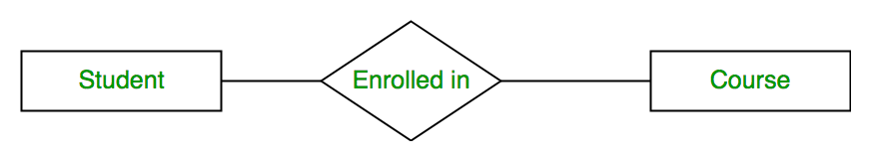
E-R diagram for student and course

Slide 9
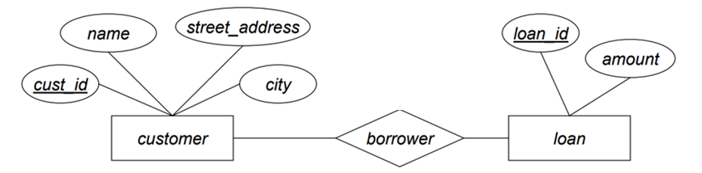
E-R diagram for customer and Loan

Slide 10
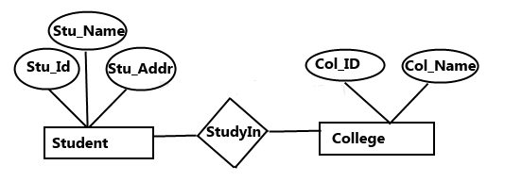
E-R diagram for student and course

Slide 11


